Slide 1
Matplotlib

Slide 2
Matplotlib
Matplotlib is a popular Python library used for creating high-quality 2D and 3D plots, charts, and graphs. It is widely used in scientific computing, data analysis, and data visualization.
Matplotlib supports various types of plots, including line plots, scatter plots, bar charts, histograms, and more.
Matplotlib is ideal for visualizing data, making it easier to understand complex data sets and trends.
It is widely used in scientific research and development for creating plots and visualizations.
Matplotlib is a valuable tool for teaching data visualization and plotting techniques to students.
It is used in various industries, such as finance, healthcare, and engineering, for data analysis and visualization.

Slide 3
What we can do using matplotlib?
Plotting
Customizations
Cross-Platform Compatibility
Line Plots
Scatter Plots
Bar Plots
Histograms
Pie Charts
3D Plots etc.
Customizable Fonts and Labels
Line Styles
Labels and Titles
Grid and Axis Settings
Colors and Colorbars
Zooming and Panning
Saving Plots
NumPy Integration
Seaborn Integration
Pandas Integration

Slide 4
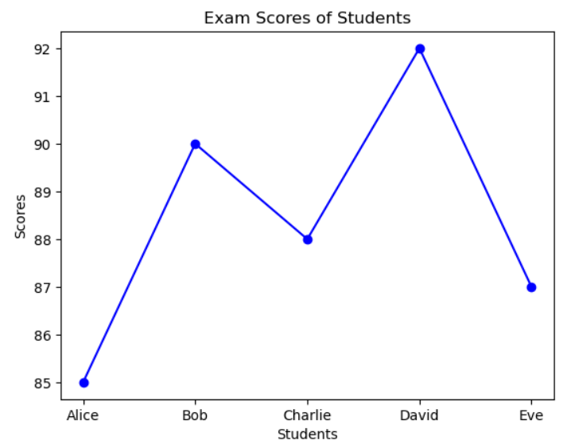
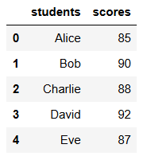
Different types of plots:
There are so many types of plots we can plot by using matplotlib, here for example we take a sample data
and try to make some plots.
plt.plot(students, scores)
Line plot:
Line plot is the basic and default plot ,it is used for showing the relation between two attributes on a plot and it represents data points connected by straight lines on a graph.

Slide 5
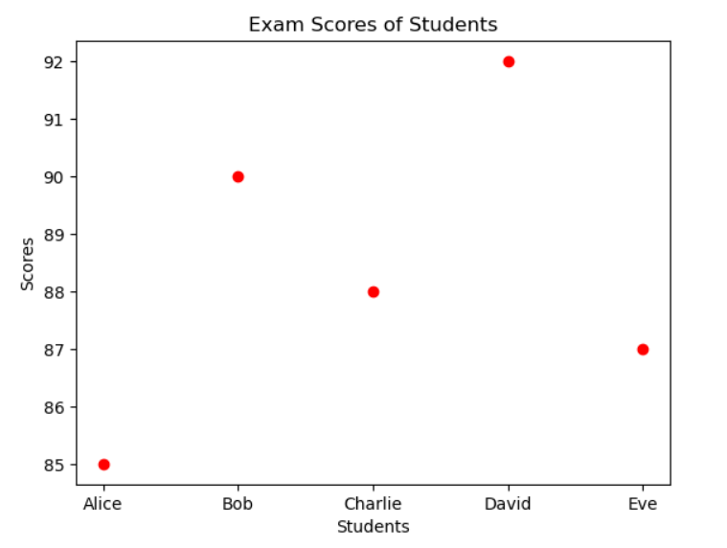
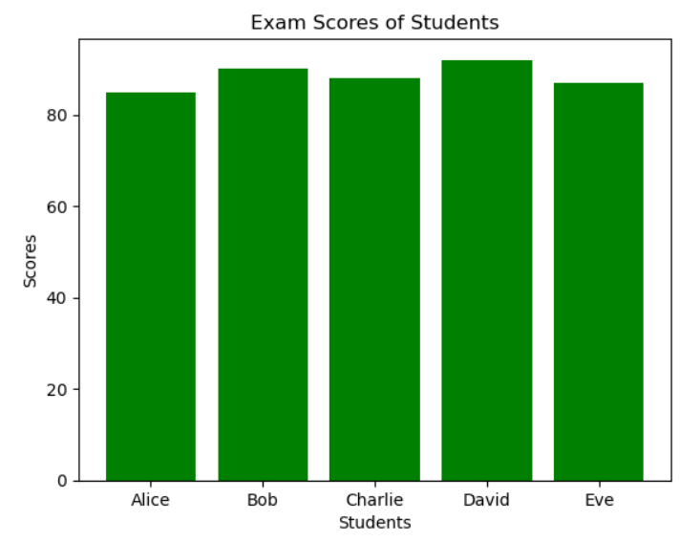
Scatter plot:
bar plot:
plt.scatter(students, scores)
plt.bar(students, scores, color='g')

Slide 6
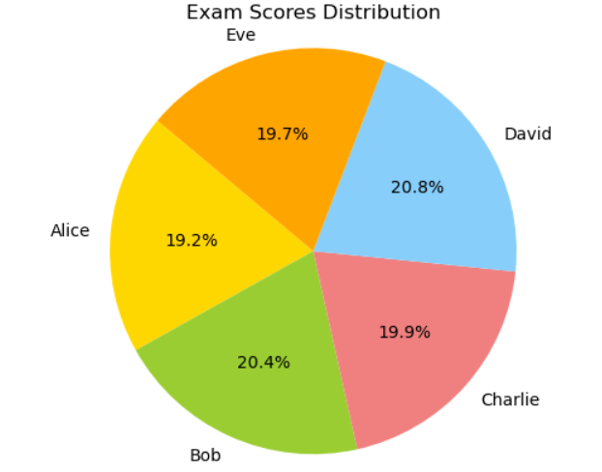
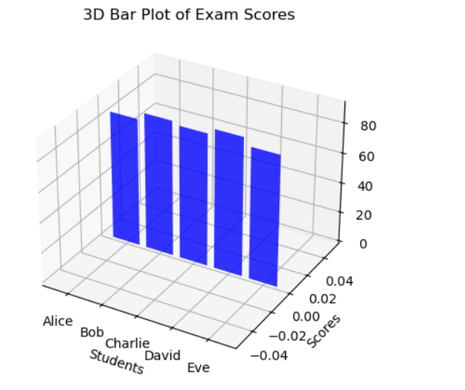
Pie Chart:
Scatter plot:
plt.pie(scores, labels=students, autopct='%1.1f%%', startangle=140,colors=['gold', 'yellowgreen', 'lightcoral', 'lightskyblue', 'orange'])
ax = fig.add_subplot(111, projection='3d')
ax.bar(students, scores, zs=0, zdir='y' )

Slide 7
Plotting Techniques
As there are a lot of plotting types . Still a plot is useless if it doesn’t able to give the exact info of what we are showing on it. For Ex: we can’t identify a plot’s use if there are no title of the plot and no labels on that plot . So, here we need more techniques to improve one plot to be more readable than using different types of plots .
There are some techniques like ,
Customizing Colors
Adding Legends
Adding Titles and Labels
Adjusting Axis Limits
Adding Annotations
Adjusting Tick Marks
Using Logarithmic Scales
Overlaying Plots
Adding Gridlines
Subplots
Adjusting Figure Size
Saving Plots

Slide 8
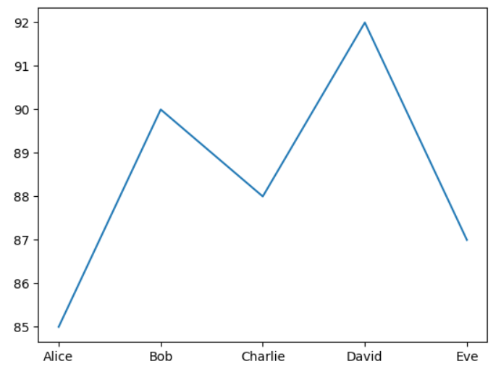
Plotting Techniques
Here this plot is the basic line plot which shows the plot between students and their scores as we’ve seen before .
This plot does’nt used any labels and title for this .
so, we cant identify what is its purpose and what the labels are showing .
we can’t even identify the datapoints also.
The line is also very thin and color is light blue , So not everyperson can study the plot perfectly .
So, we need to use some techniques .
plt.plot(students, scores)
plt.show()

Slide 9
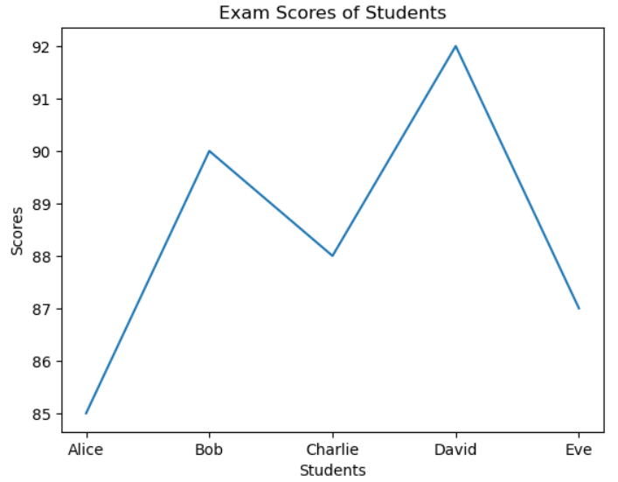
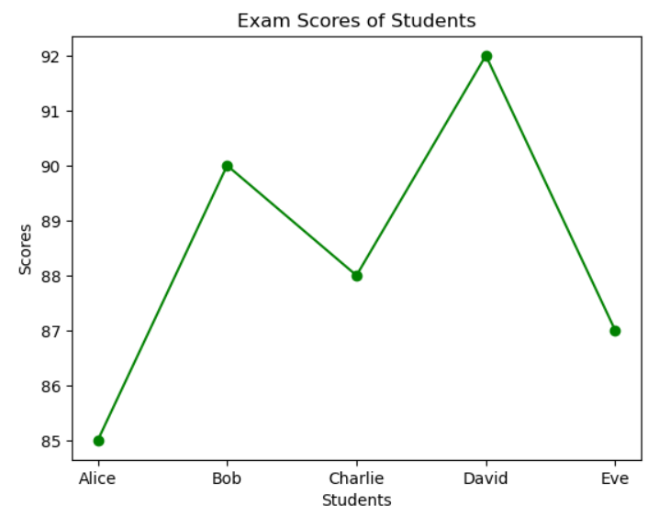
Adding Lables and Title
Changing colors:
plt.xlabel('Students')
plt.ylabel('Scores')
plt.title('Exam Scores of Students')
plt.plot(students, scores, marker='o', color='g')
Previous plot is upgraded with the axis labels and plots .
and then we used marker to identify datapoints and also changed the color to green so it would be much clear

Slide 10
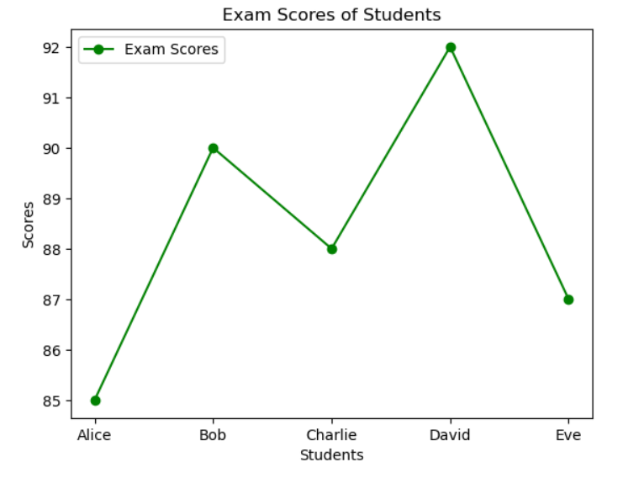
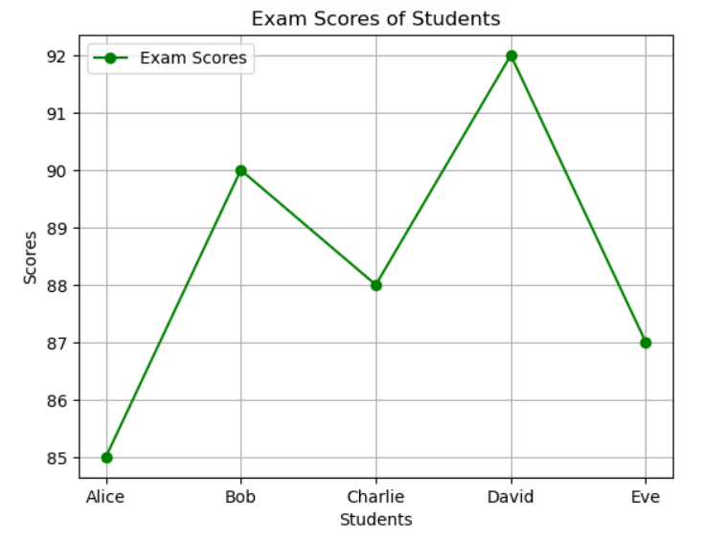
Using Legend
Using Grid:
plt.plot(students, scores,label='Exam Scores')
plt.legend()
plt.grid(True)
We used legend to identify which data line is belongs to which plot , this helps in overlaying plots .
We used grid to identify the datapoints more clearly .

Slide 11
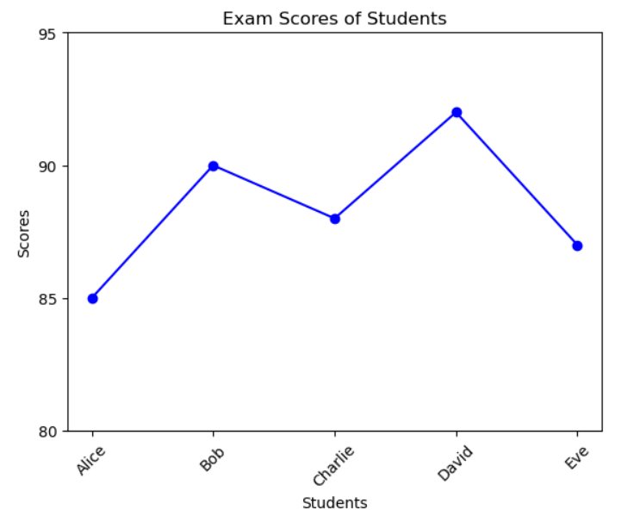
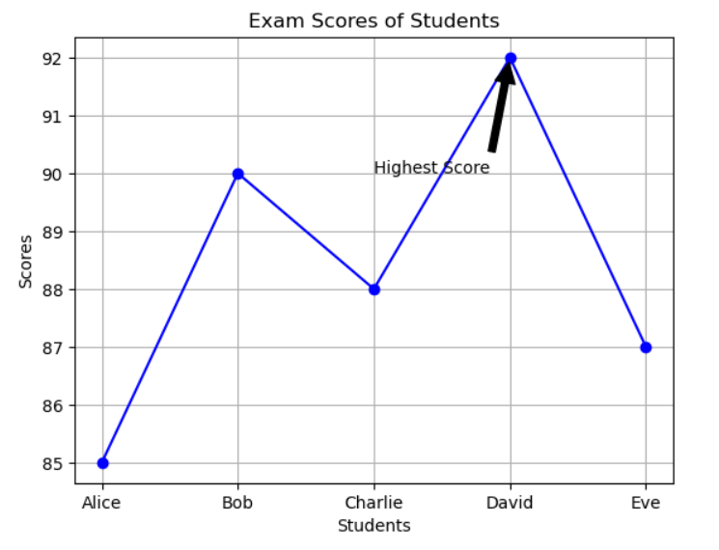
Adjusting Limits
Using Annotations
plt.annotate('Highest Score', xy=(students[scores.index(max(scores))], max(scores)),
xytext=(2, 90), arrowprops=dict(facecolor='black', shrink=0.05))
plt.xticks(rotation=45)
plt.yticks(np.arange(80, 100, 5))
Using Xticks and yticks we can change the limits and also can rotate the labels for better visualization.
Annotations helps to show the specifies datapoints on plots.

Slide 12
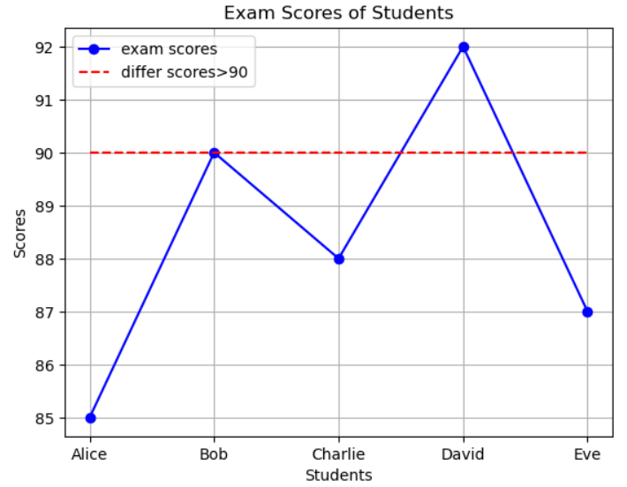
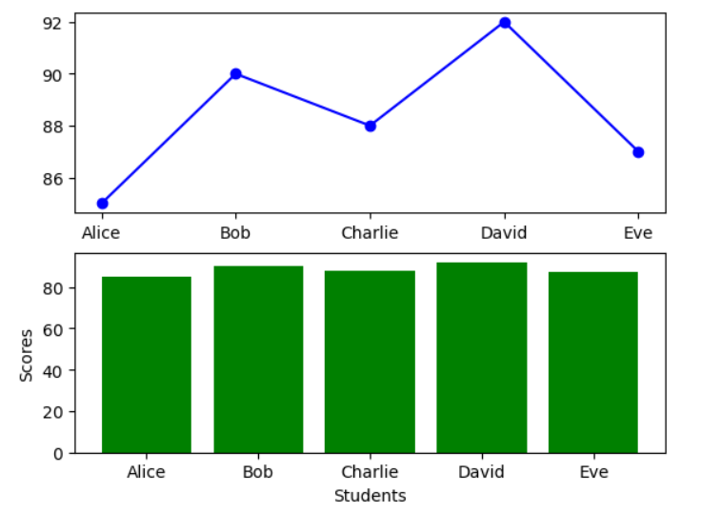
Overlaying Plots
Sub Plots
plt.plot(students, scores)
plt.plot(students, [90]*len(students))
fig, ax = plt.subplots(2, 1)
ax[0].plot(students, scores, marker='o', color='b')
ax[1].bar(students, scores, color='g')
Both the plots helps us to read the multiple plots at a time but overlaying plots are multiple plots on same graph where sub plots are multiple plots on same image .
In addition to these there are a lot of different techniques to use on different types of plots for better understaing the data .

Slide 13
Thank You

